Slide 1
Sonifying Your Presentation For Accessibility
Clara Brasseur
PhD Student University of St. Andrews
Astronify Lead Developer
13 November, 2021

Slide 2
What is sonification
Representing data as sound
*Not data that is sound

Slide 3
Our Thesis
Sonification should be ubiquitous at meetings
Every plot shown on a slide should be accompanied by a sonified version of it, but they are not. Why?
Tools aren’t widely known and easy to use.
Speakers don’t feel a need, who in the audience would benefit?
BVI attendees aren’t in the audience because lack of accessibility… the cycle continues

Slide 4
Technical challenges
Creating sonifications is like creating visualizations: it requires practice and effort
No single tool can sonify everything well
But…

Slide 5
Technical challenges
We need:
Well publicized, well designed, user friendly sonification tools
Tools designed by and in collaboration with BVI developers
Training resources for creating useful sonifications

Slide 6

astronify.readthedocs.io
Open source Python codebase
Community driven development
Integration into standard workflow
Code is on GitHub Documentation on readthedocs
Out in beta (pip install astronify)
Open for issues and pull requests
Can run from python scripts/interpreters

Slide 7

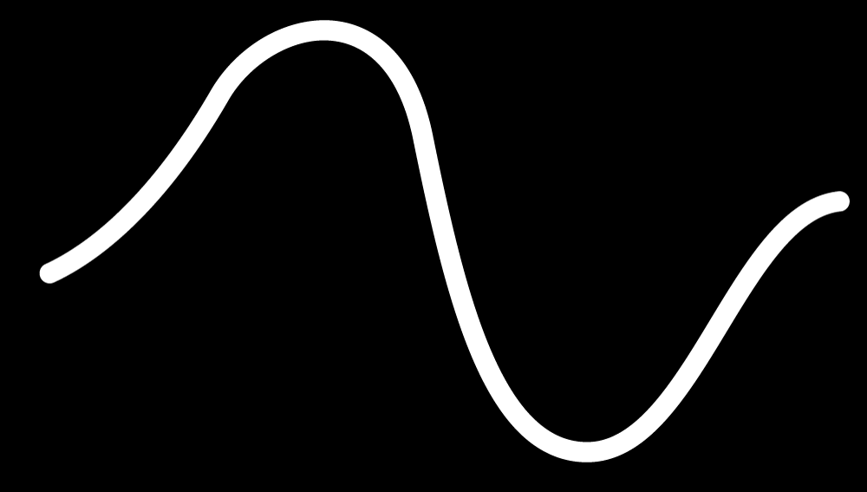
a python package that sonifies light curves
:
brighter
higher
pitch
light
dimmer
lower
time

Slide 8
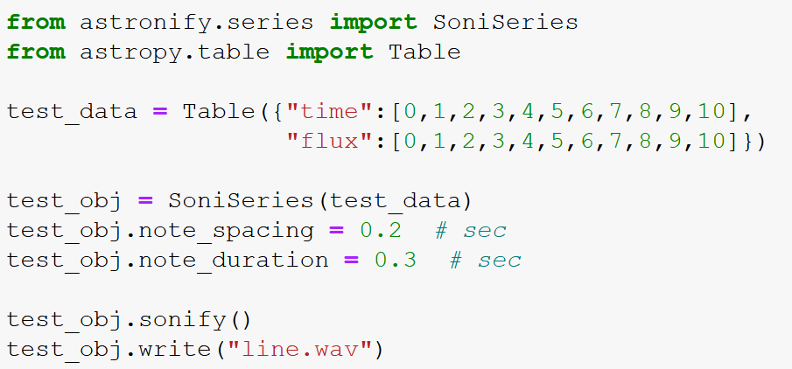
basic usage
:

Slide 9
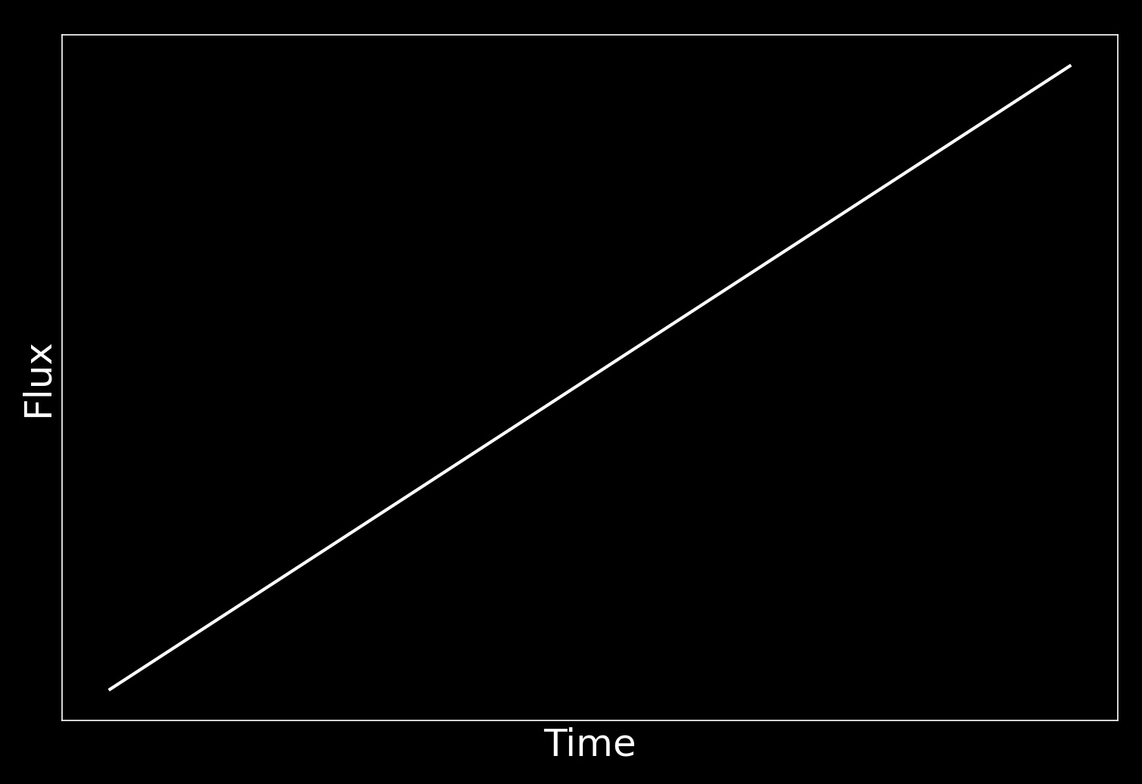
basic usage
:

Slide 10
Ideal usage
:
Best suited for sonifying line plots
Optimized for light curves from TESS/Kepler missions
Under active development (contributions welcomed!)
Use in conjunction with other audio processing software for more complex plots

Slide 11
Example Application
:
Let’s sonify some plots from a recent talk I gave on stellar flares!
Caveats:
This is not the entire talk, I wish I had time for that.
Asronify is not suitable for sonifying everything, I did select plots with that in mind
Audacity was used for additional audio processing

Slide 12
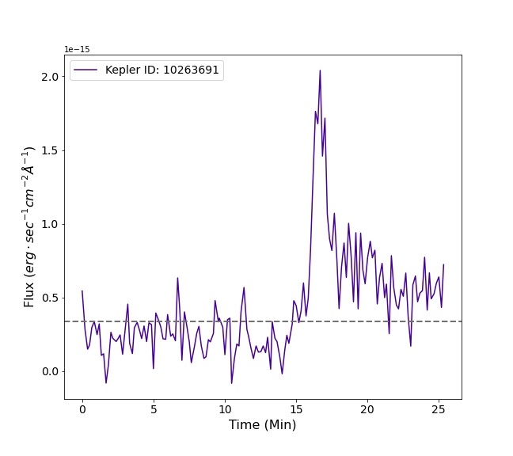
Plot 1, flaring light curve
:
GALEX light curve
10 second cadence
Stellar flare

Slide 13
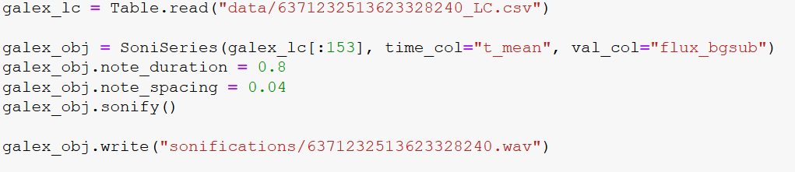
:
Plot 1, flaring light curve

Slide 14
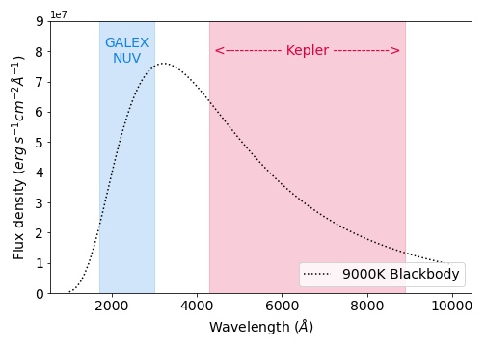
Plot 2, telescope wavebands
:
9000 K blackbody
NUV waveband is near the peak of emission

Slide 15
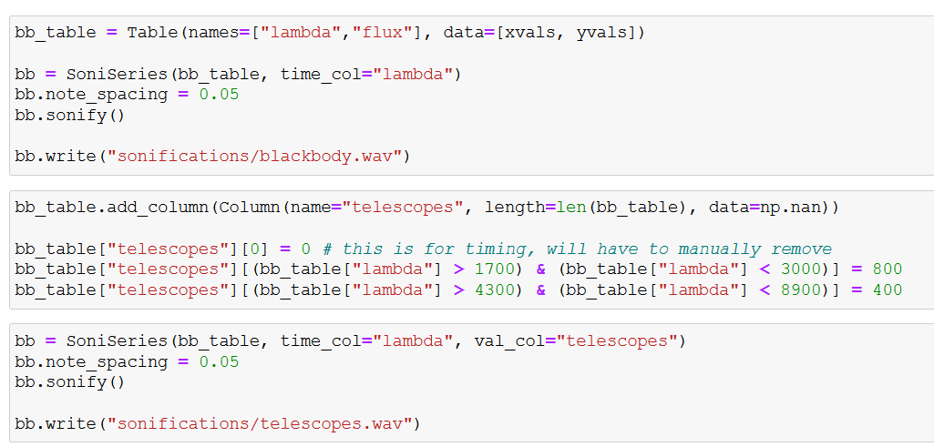
Plot 2, telescope wavebands
:
Blackbody Curve
!!
Telescope passbands
** Must manually mix into single track **

Slide 16
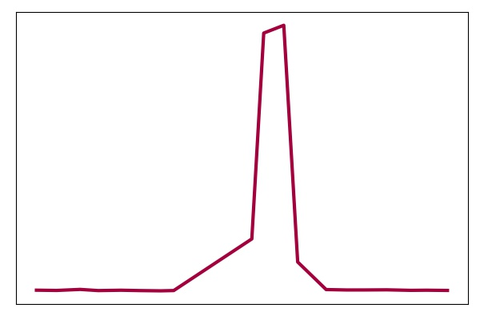
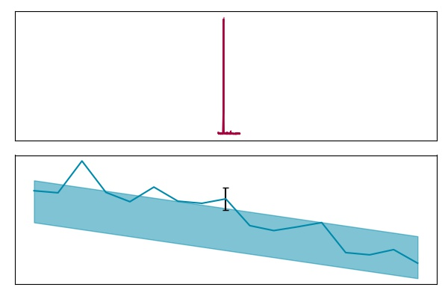
Plot 3, multiwavelength flares
:
GALEX flare
GALEX vs Kepler
Data cadence mismatch
GALEX flare/Kepler non-detection
Kepler “flare”
Quiescent flux

Slide 17
Plot 3, multiwavelength flares
:
Sonify each line individually
Mix together using external audio processing software (Audacity)
Astronify goals:
Sonify multiple data series together
Allow for a non-zero starting offset

Slide 18
Try
astronify.readthedocs.io
github.com/ceb8/SciAccess2021_Astronify

